Slide 1
Sentiment Analysis
SlideMake.com

Slide 2
Content:
Objective
Introduction to sentiment analysis
Dataset
Importance of sentiment analysis
Visualization
Applications of Sentiment Analysis
Techniques Used in Sentiment Analysis
Challenges in Sentiment Analysis
Ethical Considerations in Sentiment Analysis
Conclusion
References
Notes:
Image source: https://www.researchgate.net

Slide 3
Objective :
Extracting sentiment from customer reviews on a product.
Notes:
Image source: https://www.researchgate.net

Slide 4
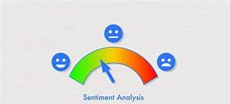
Introduction to Sentiment Analysis
Sentiment analysis is the process of determining the emotional tone behind a series of words.
It is widely used to understand customer opinions, social media sentiments, and market trends.
This technique leverages natural language processing (NLP) to assess text data for sentiment polarity.
Notes:
Image source: https://www.researchgate.net

Slide 5
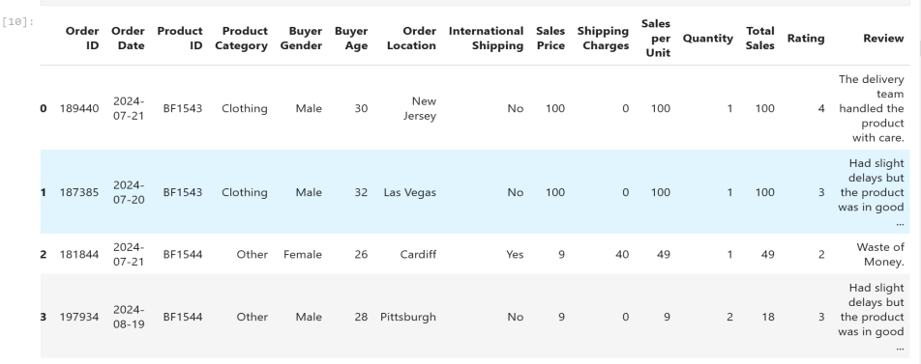
Dataset :
Notes:
Image source: https://www.researchgate.net

Slide 6
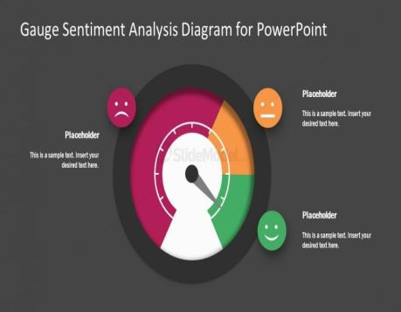
Importance of Sentiment Analysis
Businesses use sentiment analysis to gauge public opinion about their products and services.
It helps organizations make data-driven decisions based on customer feedback and trends.
By analyzing sentiment, companies can improve customer engagement and experience.
Notes:
Image source: https://slidemodel.com

Slide 7
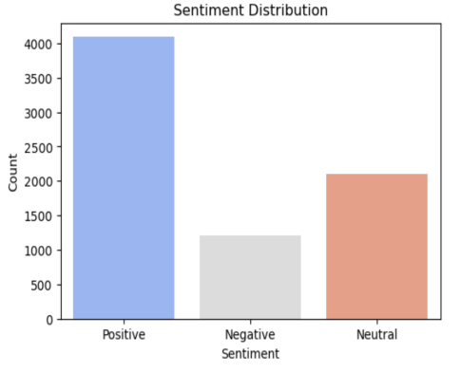
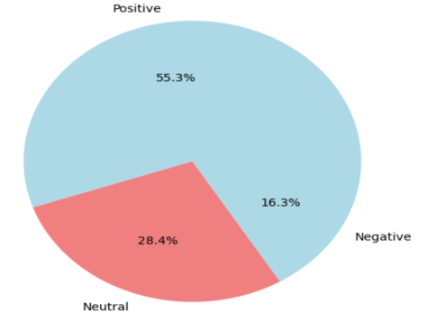
Visualisation :
Sentiment pie chart
Notes:
Image source: https://slidemodel.com

Slide 8
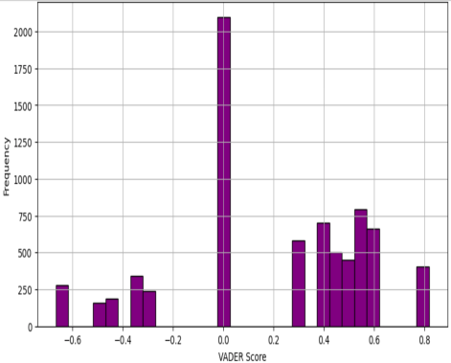
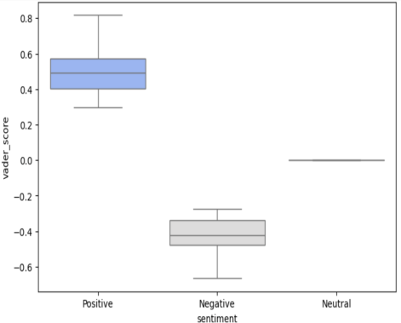
Visualisation :
Histogram of VADER sentiment score
Boxplot of VADER Sentiment scores by sentiment
Notes:
Image source: https://slidemodel.com

Slide 9
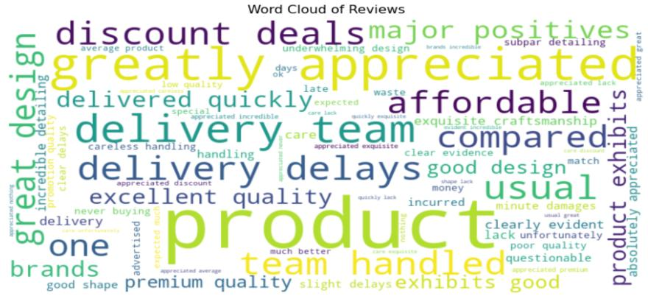
Visualisation :
Notes:
Image source: https://slidemodel.com

Slide 10
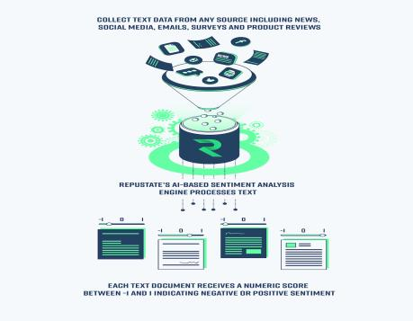
Applications of Sentiment Analysis
Sentiment analysis is used in brand monitoring to track public perceptions over time.
It plays a crucial role in political campaigns to analyze voter sentiments and opinions.
In finance, it assists investors in making informed decisions based on market sentiment.
Notes:
Image source: https://www.repustate.com

Slide 11
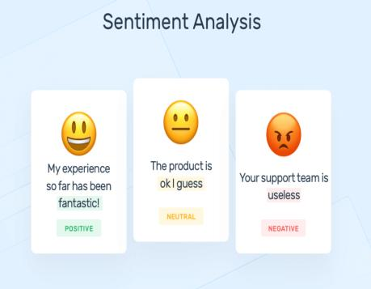
Techniques Used in Sentiment Analysis
Machine learning models, such as Naive Bayes and Support Vector Machines, are commonly applied.
Deep learning approaches utilize neural networks to enhance sentiment prediction accuracy.
Lexicon-based methods analyze sentiment through predefined word lists and their associated sentiments.
Notes:
Image source: https://vitalflux.com

Slide 12
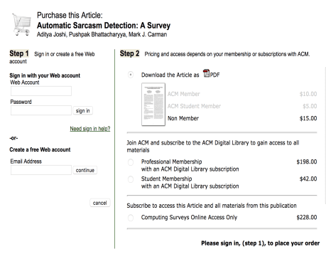
Challenges in Sentiment Analysis
Sarcasm and irony pose significant challenges in accurately interpreting sentiment.
Contextual nuances can lead to misclassification of sentiments in short texts.
The diversity of languages and dialects complicates the development of universal sentiment models.
Notes:
Image source: https://community-cdn.rstudio.com

Slide 13
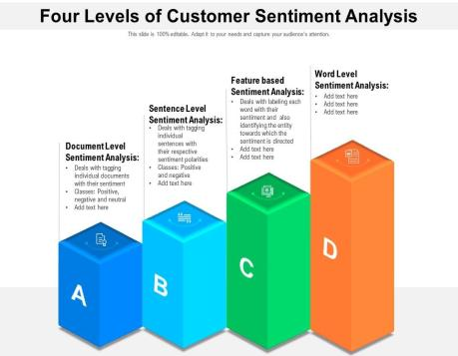
Case Studies in Sentiment Analysis
Companies like Netflix use sentiment analysis to tailor content recommendations for users.
Airlines monitor social media sentiment to address customer complaints in real-time.
Retailers analyze product reviews to enhance their offerings and improve customer satisfaction.
Notes:
Image source: https://www.slideteam.net

Slide 14

Future of Sentiment Analysis
Advancements in AI and machine learning will improve the accuracy of sentiment predictions.
Real-time sentiment analysis will become more prevalent as data sources expand.
Greater emphasis will be placed on multilingual sentiment analysis to reach broader audiences.
Notes:
Image source: https://www.slidemake.com

Slide 15
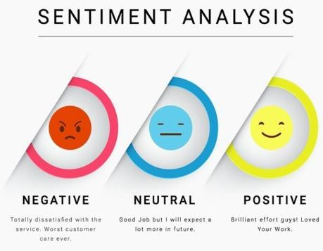
Ethical Considerations in Sentiment Analysis
The use of sentiment analysis raises privacy concerns regarding data collection and user consent.
Bias in training data can lead to skewed interpretations of sentiment, impacting decisions.
Transparency in algorithms is crucial to maintain trust and accountability in sentiment analysis applications.
Notes:
Image source: https://www.datasciencecentral.com

Slide 16
Conclusion
Sentiment analysis is a powerful tool that enables organizations to understand public opinion.
As technologies evolve, the applications and accuracy of sentiment analysis will continue to grow.
Understanding its challenges and ethical implications is essential for responsible use in various sectors.
Notes:
Image source: https://www.slidemake.com

Slide 17
References
Liu, B. (2012). Sentiment Analysis and Opinion Mining. Morgan & Claypool.
Pang, B., & Lee, L. (2008). Opinion Mining and Sentiment Analysis. Foundations and Trends in Information Retrieval.
Cambria, E., & White, B. (2014). Jumping NLP Curves: A Review of Common Semantic Models for Text Processing.

